Slide 1

Implementation of Double SHA-256 in HLS for FPGA Using Real Bitcoin Blocks
Bernardo V. S. Pinto, Douglas R. Melo, Cesar A. Zeferino, Eduardo A. Bezerra, Felipe Viel
LEDS, Universidade do Vale do Itajaí, Brasil
berna@edu.univali.br
Notes:
Hi everyone,
My name is Bernardo Pinto, and I’m from the LEDS Research Group at Universidade do Vale do Itajaí, in Brazil. Today, I’ll be presenting our work titled “Implementation of Double SHA-256 in HLS for FPGA Using Real Bitcoin Blocks.” Our goal was to design and evaluate a hardware accelerator capable of performing Bitcoin’s double SHA-256 hashing directly on FPGA platforms, using real blockchain data.

Slide 2
Outline
Introduction
Background
Related Work
Proposed Architecture
Experimental Platforms
Development
Results
Conclusion
Notes:
Here is the outline of my presentation. I will start with a brief introduction and background, explaining the motivation behind this work. Then, I’ll discuss the related research and how our approach differs. After that, I’ll go through the proposed architecture and the experimental platforms we used — namely, the ZedBoard and the ZCU104. Next, I’ll show the development process, results, and finally, the main conclusions and possible future improvements.

Slide 3

Introduction
Bitcoin relies on the Double SHA-256 algorithm to ensure block integrity.
This algorithm demands high computational power and energy.
FPGAs offer reconfigurability and lower energy consumption.
Research Problem
Develop an HLS-based architecture capable of performing the complete Double SHA-256 computation on FPGA using already mined blocks.
Evaluate the performance of the FPGA solution on ZedBoard and ZCU104 platforms, comparing the ARM CPU with the programmable logic accelerator.
Notes:
Bitcoin’s security depends on the Double SHA-256 algorithm, but it requires high computational power and energy. ASIC miners are fast but expensive and fixed-function. Using High-Level Synthesis lets us design FPGA hardware quickly in C or C++, making development faster and more accessible.
In this work, we address the computational challenges of Bitcoin’s Double SHA-256 algorithm. We propose an FPGA implementation using High-Level Synthesis and evaluate it on two platforms: ZedBoard and ZCU104. Our goal is to validate real Bitcoin blocks and compare the performance and energy efficiency with CPUs, GPUs, and ASIC miners.

Slide 4
Background

Slide 5
Background
Bitcoin block validation uses the Double SHA-256 algorithm.
The algorithm is computationally intensive and highly parallel.
Early mining was CPU-based, but network difficulty grew.
ASICs became dominant — high performance, but costly and inflexible.
Notes:
Bitcoin mining relies on validating block headers using Double SHA-256, a process that demands massive parallel computation. At first, CPUs could handle this, but as difficulty increased, ASICs took over because of their high performance — though they’re expensive and rigid.

Slide 6
Background
FPGAs offer reconfigurable and energy-efficient hardware.
Enable custom hardware acceleration for specific applications.
HLS allows complex algorithms to be written in C/C++ and synthesized into RTL.
Reduces development time while maintaining hardware-level performance.
This work uses HLS to implement Double SHA-256 on FPGA with real Bitcoin blocks.
Notes:
FPGAs provide a middle ground between flexibility and performance, using less power than GPUs or ASICs. With High-Level Synthesis, we can describe algorithms in C or C++ and generate hardware automatically, which speeds up development. Our project applies this to implement Double SHA-256 on real Bitcoin data.

Slide 7
Related Work

Slide 8
Related Work
Author / Year | Platform / Method | Main Contribution | Results
Santos Júnior et al., 2024 | Xilinx Virtex-6, 16 parallel SHA-256 cores | Reconfigurable hardware for SHA-256 in blockchain/IoT​ | 1.4 Gbps throughput, 234× lower dynamic power
Dang & Skadron, 2017 | FPGA with SDAccel & Vivado HLS | Acceleration of data-mining algorithm (FIM)​ | 3.2× faster than CPU, higher energy efficiency
Kammoun et al., 2020​ | FPGA + ARM (Vivado HLS) | SHA-256 optimization using unrolling and pipelining​ | 73% less energy, 17% faster than software
Notes:
Previous studies have shown the benefits of using FPGAs for cryptographic and data-intensive workloads. Santos Júnior implemented a reconfigurable SHA-256 core on a Virtex-6 FPGA, reaching 1.4 Gbps with much lower power. Dang and Skadron used HLS to accelerate data mining algorithms, achieving over three times the CPU performance. Kammoun’s work focused on optimizing SHA-256 with loop unrolling and pipelining, reducing energy by more than seventy percent.

Slide 9
Discussion of Related Work
Prior works applied FPGA acceleration to SHA-256 and data-intensive algorithms.
Results show high performance and strong energy efficiency.
However, most studies target synthetic or mining benchmarks.
Our work focuses on real Bitcoin block validation using Double SHA-256.
Notes:
Unlike these, our work validates real Bitcoin blocks, demonstrating a complete Double SHA-256 implementation for blockchain verification.

Slide 10
Proposed Architecture

Slide 11
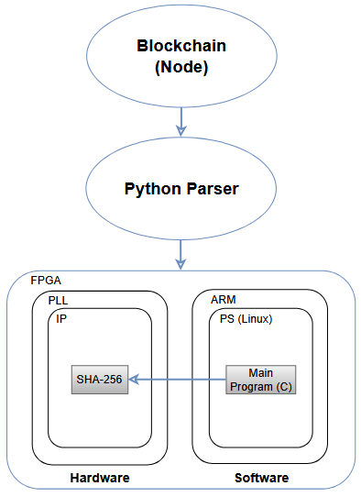
Proposed Architecture
The system performs the Double SHA-256 on real Bitcoin block headers.
It replicates the same validation mechanism used in the Bitcoin network.
The architecture integrates a custom HLS-based SHA-256 IP with an ARM processor.
Communication between PS (ARM) and PL (FPGA) uses AXI4-Lite.
Results are compared against real blockchain data for validation.
Overview of the proposed architecture using real Bitcoin blocks
Notes:
The proposed architecture executes the Double SHA-256 algorithm on real Bitcoin block headers, reproducing the exact validation process used by full Bitcoin nodes. It combines an ARM processor with a custom FPGA core synthesized through High-Level Synthesis. Both components communicate via AXI4-Lite interfaces to achieve low-latency data transfer. Finally, the system verifies the resulting hash against actual blockchain data to ensure correctness.

Slide 12
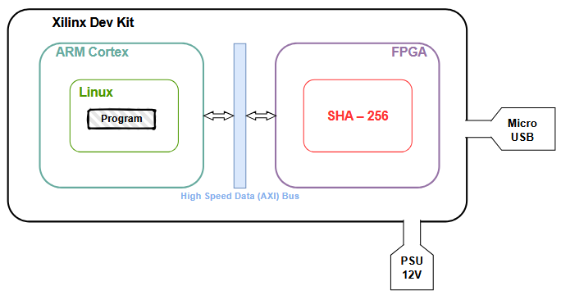
Proposed Architecture
Double SHA-256 IP Design:
Internal hardware architecture with SHA-256 core implemented on FPGA.

Slide 13
Proposed Architecture
Double SHA-256 IP Design:
Implemented in C using Vivado HLS.
Two sequential SHA-256 stages for Bitcoin double hashing.
64 compression rounds per stage (512-bit blocks).
Optimization with loop unrolling and pipelining directives.
Exposes memory-mapped registers for easy integration via AXI4-Lite.
Notes:
The Double SHA-256 core was implemented in C and synthesized using Vivado HLS. It runs two consecutive hashing stages to match Bitcoin’s double-hash specification. We applied optimization directives like loop unrolling and pipelining to balance speed and area. The IP exposes simple memory-mapped registers, making it easy to control from the ARM processor.

Slide 14
Experimental Platforms

Slide 15
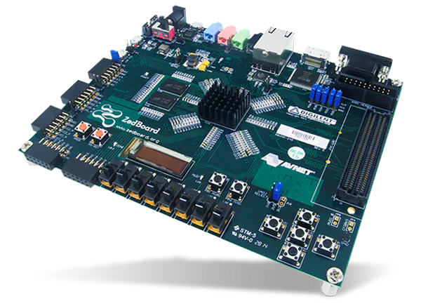
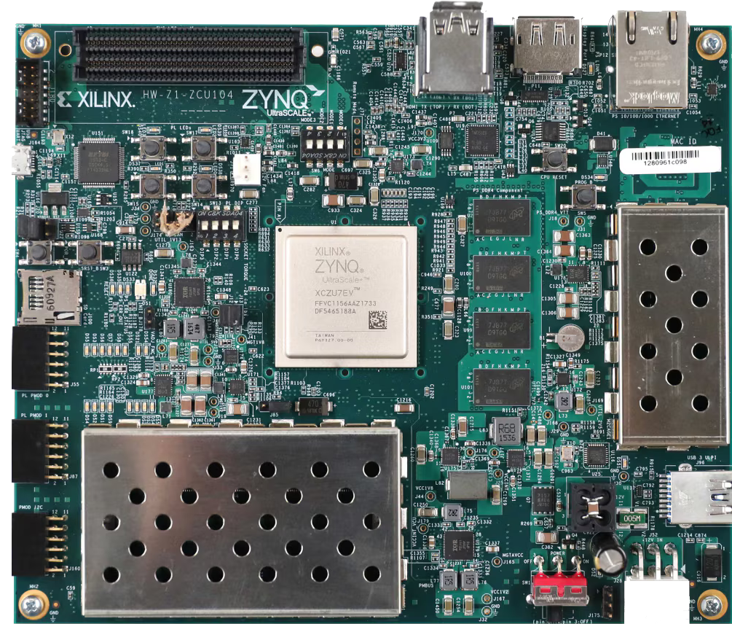
Experimental Platforms
FPGA Platforms Used:
ZedBoard Zynq-7000
AMD Zynq™ UltraScale+™ MPSoC ZCU104
Notes:
Two FPGA platforms were used in this work: the ZedBoard and the ZCU104.

Slide 16
Experimental Platforms
FPGA Platforms Used:
Two Xilinx development boards were used for implementation and testing.
ZedBoard (Zynq-7000): cost-effective entry-level SoC FPGA.
ZCU104 (Zynq UltraScale+ MPSoC): high-performance heterogeneous platform.
Both integrate ARM processors with programmable logic through AXI interfaces.
Enables comparison between low-cost and high-end FPGA systems.
Notes:
The ZedBoard, based on the Zynq-7000, is a cost-effective SoC with dual Cortex-A9 processors — ideal for embedded testing. The ZCU104, part of the UltraScale+ family, offers a much larger FPGA fabric, quad Cortex-A53 CPUs, and faster DDR4 memory. By using both, we could compare scalability and performance between entry-level and high-end FPGA systems.

Slide 17
Development

Slide 18
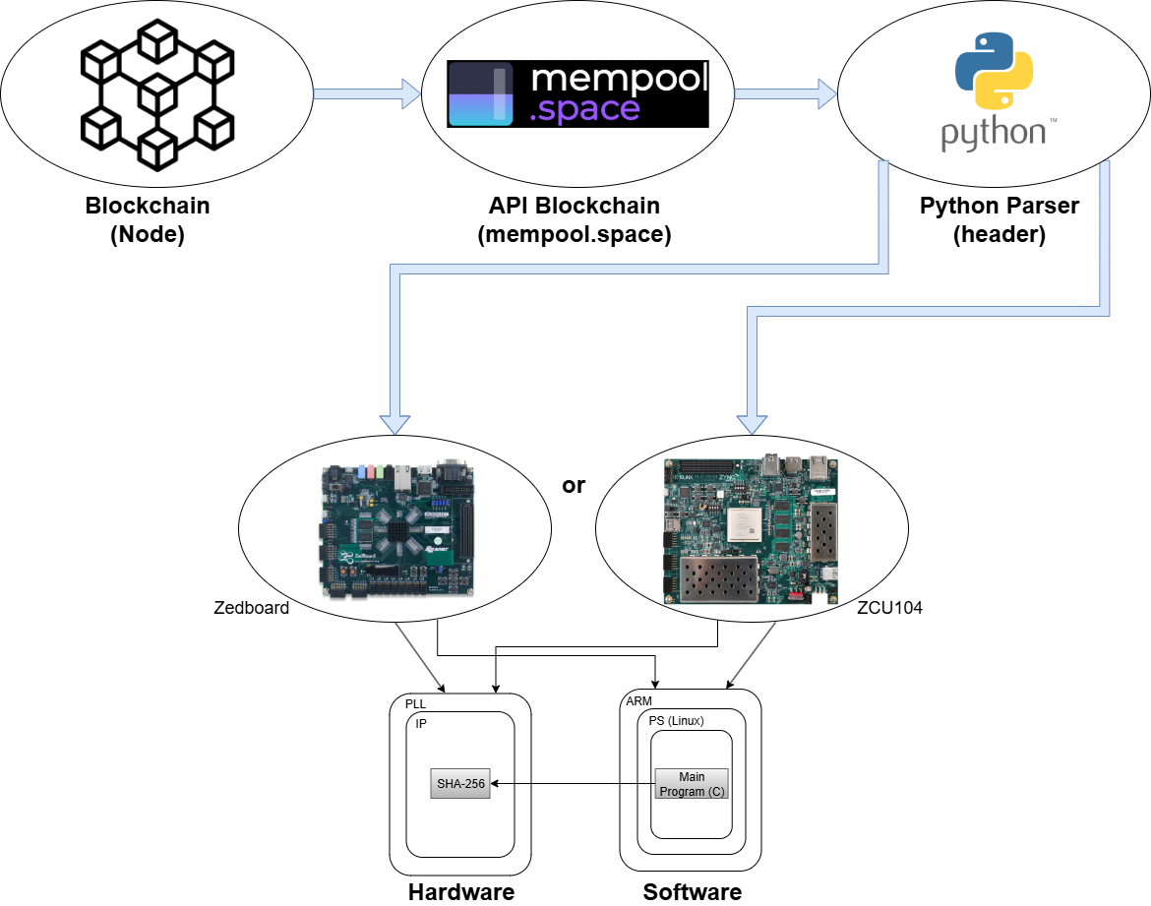
Development
Double SHA-256 IP Design:
System overview showing data flow from blockchain to FPGA accelerator.
Notes:
This diagram shows the complete data flow of our system, from the blockchain to the FPGA accelerator. Real Bitcoin block headers are obtained through the mempool.space API, which provides live blockchain data. A Python parser processes this information and formats it into the 80-byte block header used in Bitcoin’s Double SHA-256 validation. The formatted header is then sent to one of our FPGA platforms — either the ZedBoard or the ZCU104 — where the Double SHA-256 IP core is implemented. On the FPGA side, the Processing System (ARM processor) runs a bare-metal application that communicates with the Programmable Logic, which executes the hashing. This setup allows us to validate real blockchain data directly in hardware, just like a Bitcoin full node would.

Slide 19
Development
Double SHA-256 IP Design:
SHA-256 core developed in C and synthesized with Vivado HLS.
Two sequential hashing stages for Double SHA-256.
Each stage processes 512-bit blocks through 64 compression rounds.
Pipelined and optimized with loop unrolling and initiation intervals.
Exposes memory-mapped registers for easy control via AXI4-Lite.
Notes:
The SHA-256 core was developed in C and synthesized using Vivado HLS. It performs two sequential hashing stages to replicate the Double SHA-256 used in Bitcoin. Each stage handles 512-bit message blocks and was optimized with loop unrolling and pipelining. The core communicates with the ARM processor through AXI4-Lite, allowing full hardware control from software. This architecture makes it easy to scale or reuse the design in future FPGA systems.

Slide 20
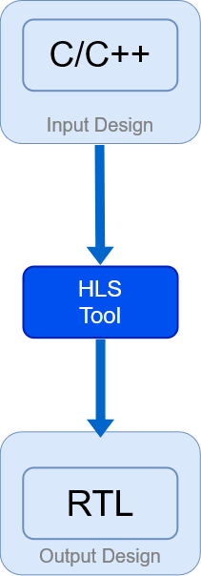
Development
Materials:
Computer: host platform for software development and testing.
Vivado Design Suite: – Used for IP integration, synthesis, and FPGA bitstream generation. – Vivado HLS used for C-to-RTL conversion and performance optimization.
Languages: – C/C++ for algorithm and bare-metal control code. – HLS for FPGA synthesis and optimization.
FPGA: – Executes the Double SHA-256 hardware design. – Collects performance metrics and hashrate data.
Wattmeter: – Monitors real-time power consumption. – Records data for energy efficiency analysis.
Notes:
This slide summarizes the main tools and methods used in the development. The algorithm and control software were written in C and C++, while High-Level Synthesis was used to convert the code into hardware logic.
The main Vivado IDE was used to integrate the generated IP into the system block design, perform synthesis, and generate the FPGA bitstream. The FPGA executes the Double SHA-256 algorithm and measures performance in terms of hashrate. We also used a wattmeter to monitor the real-time power consumption, allowing us to calculate energy efficiency later on.

Slide 21
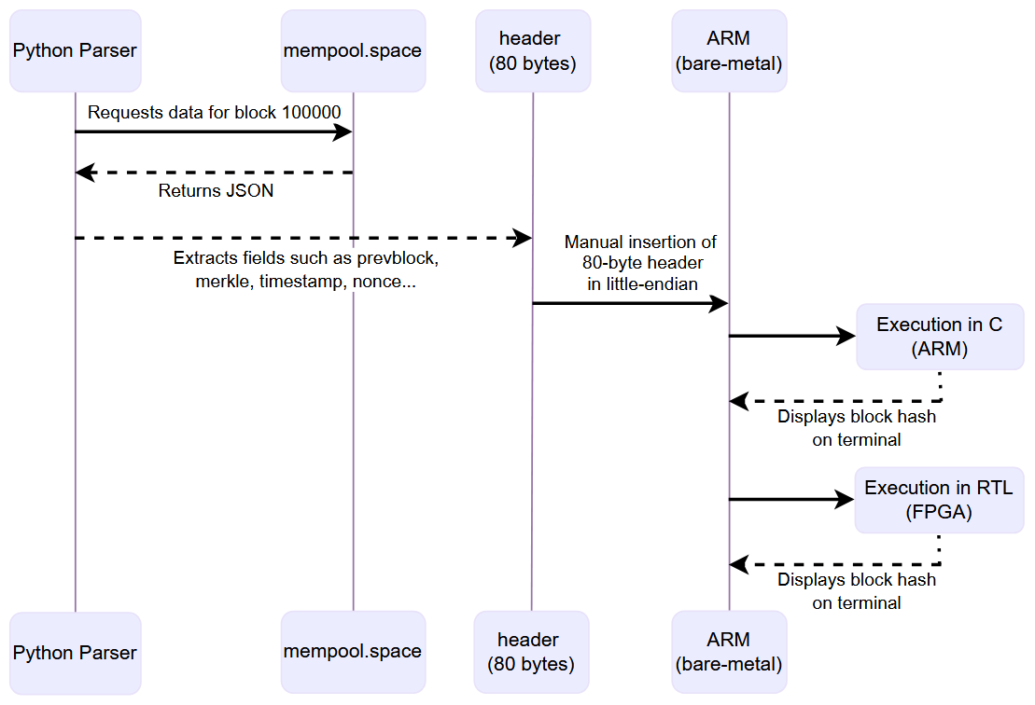
Development
Data Flow and Execution Sequence:
Sequence diagram showing how block headers are requested, formatted, and validated by the FPGA system.
Notes:
This diagram shows the detailed execution flow of our validation system. The Python parser requests data for a specific block from the mempool.space API — here we use block number 100000 as an example. The parser extracts the necessary fields, such as the previous block hash, the Merkle root, timestamp, and nonce, and builds an 80-byte header in little-endian format. This header is then sent to the ARM processor, which runs a bare-metal C application. The application can execute the Double SHA-256 either in software, directly on the ARM, or in hardware through the FPGA accelerator. In both cases, the resulting hash is displayed on the terminal for comparison and verification against the Bitcoin reference hash.

Slide 22
Development
Implementation Details:
Python parser requests and formats real Bitcoin headers.
ARM bare-metal software controls the FPGA accelerator via AXI-Lite.
FPGA executes Double SHA-256 and returns the hash for validation.
Notes:
This slide summarizes how the complete system operates in practice.

Slide 23
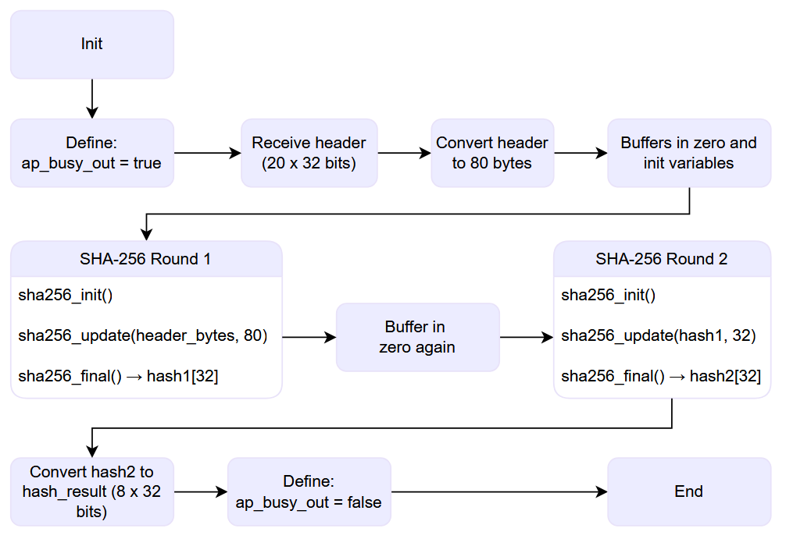
Development
SHA256_TOP Flowchart:
Flowchart showing the complete sequence of the Double SHA-256 computation inside the FPGA accelerator.
Notes:
This flowchart illustrates the internal behavior of the sha256_top function, which performs the complete Double SHA-256 computation on the FPGA. The process begins with initialization and setting the control signal ap_busy_out to true. The system then receives the 80-byte Bitcoin block header, converts it to bytes, and prepares internal buffers and variables.
The first SHA-256 round is executed, generating an intermediate hash called hash1. After clearing the buffers, the second SHA-256 round takes hash1 as input to produce the final hash, hash2.
Once the computation is complete, the output is formatted into 8 words of 32 bits and the control signal is cleared, indicating that the IP core is ready for the next operation.
This sequence fully replicates the Double SHA-256 procedure defined in the Bitcoin protocol.

Slide 24
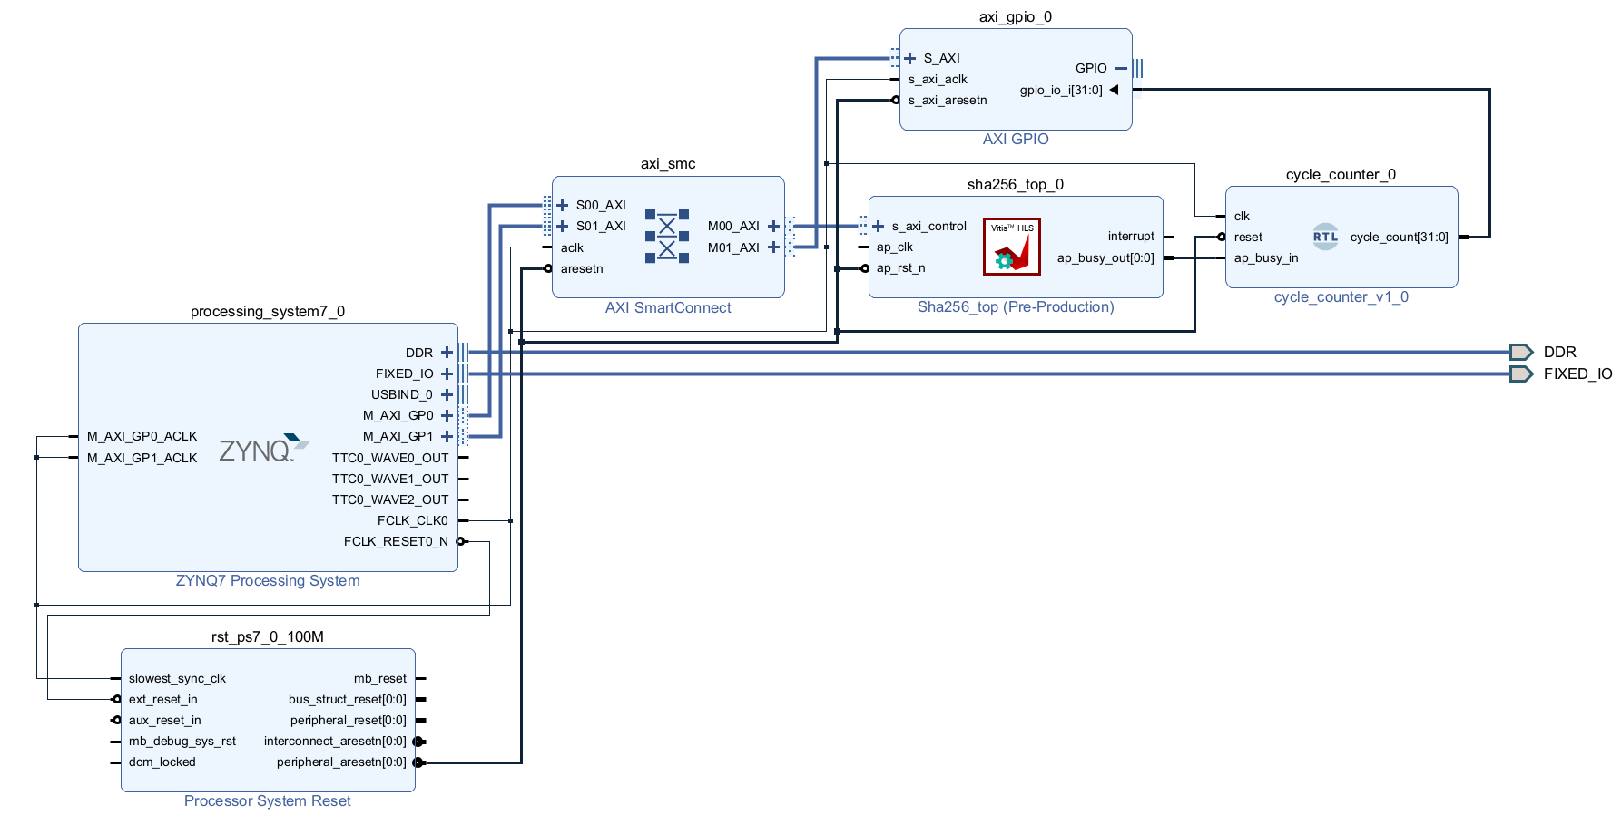
Development
Block Diagram: Zedboard ZYNQ-7000
Notes:
Here we can see the block diagram implemented on the ZedBoard, based on the Zynq-7000 SoC. The ARM Cortex-A9 processing system on the left runs the bare-metal C application, while the programmable logic region on the right hosts the custom Double SHA-256 IP generated by Vivado HLS.
Communication between the two domains is handled through the AXI4-Lite interface, which allows the ARM processor to write data into the IP registers and start the hashing process.
We also included basic peripherals such as UART for serial communication and GPIO for debugging and control. This setup provides a simple, low-cost platform for validating the complete hardware-software integration.

Slide 25
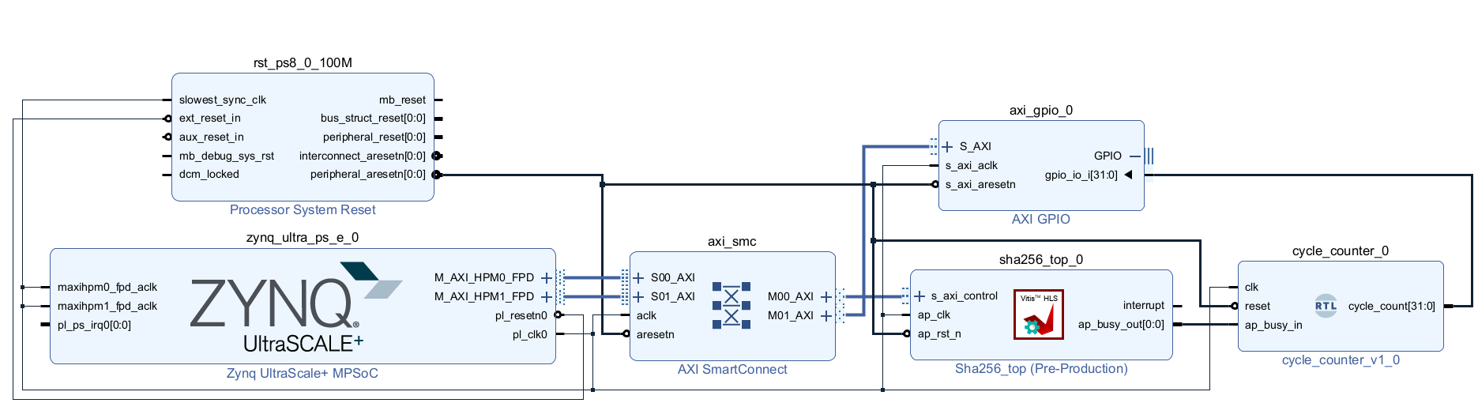
Development
Block Diagram: Zynq UltraScale+ ZCU104
Notes:
This diagram shows the same architecture implemented on the ZCU104, which belongs to the Zynq UltraScale+ MPSoC family. Compared to the ZedBoard, it provides four ARM Cortex-A53 cores and a much larger FPGA fabric, which allows higher clock frequencies and better throughput.
The communication between the Processing System and the Programmable Logic is still performed via AXI interfaces, but here we use High-Performance Master (HPM) and High-Performance Slave (HP) ports to achieve higher bandwidth.
This configuration allows the Double SHA-256 IP to process headers significantly faster, demonstrating how the same design scales efficiently from a small FPGA to a high-end platform.
We used the same IP core and software stack on both platforms, which allowed us to compare performance and energy efficiency between a low-end and a high-end FPGA.

Slide 26
Results

Slide 27
Results
Evaluation Metrics:
Execution Time: time required to complete the Double SHA-256 computation of one block, measured in seconds.
Estimated Hashrate: number of hashes computed per second, estimated from the execution time of one mining cycle for a single nonce.
Logic Resource Usage: FPGA resources consumed during synthesis and implementation, including LUTs, FFs, and BRAMs.
Maximum Operating Frequency (Fmax): maximum achievable clock frequency for the synthesized IP, reported after implementation.
Energy Efficiency: ratio between obtained hashrate and estimated platform power consumption, measured in H/s per Watt.
Performance Gain: ratio between software and hardware execution times, expressed as a speedup factor (e.g., 10×).
Notes:
Before showing the quantitative results, these are the main metrics we evaluated. We measured execution time to determine how fast each platform performs a full Double SHA-256 calculation. From that, we derived the estimated hashrate — the number of hashes per second.
We also analyzed the FPGA resource usage, including LUTs, flip-flops, and block RAMs, and the maximum operating frequency achieved after synthesis.
To understand system efficiency, we compared the hashrate against power consumption to calculate energy efficiency, and finally we computed the performance gain, showing how much faster the FPGA implementation is compared to pure software execution.

Slide 28
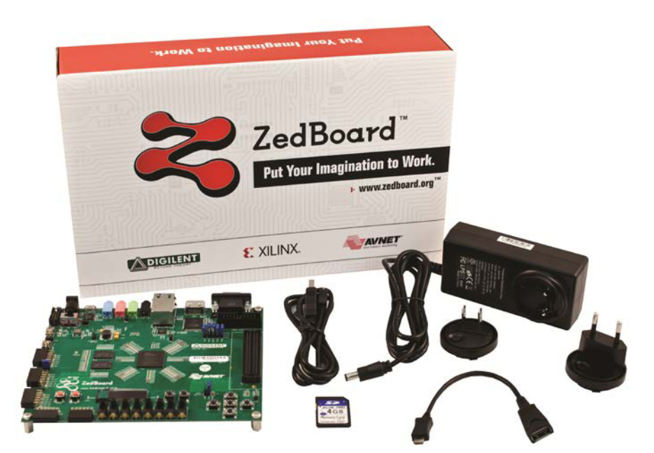
Results: Zedboard ZYNQ-7000
Notes:
First: Zedboard ZYNQ 7000

Slide 29
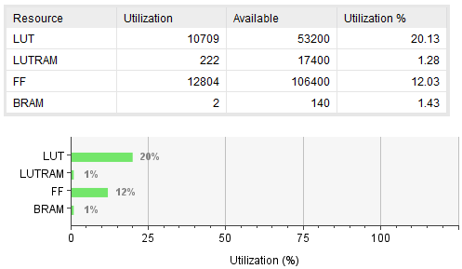
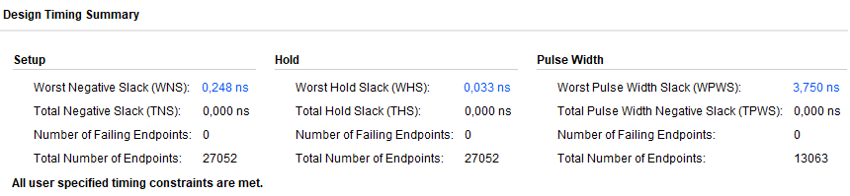
Results: Zedboard ZYNQ-7000
Utilization:
Notes:
This slide shows the FPGA resource utilization and timing results for the ZedBoard, which uses the Zynq-7000 SoC.
As we can see in the table, the SHA-256 IP core used about 20% of LUTs, 12% of flip-flops, and less than 2% of BRAM resources. This indicates a relatively small footprint, leaving plenty of logic available for future extensions or additional parallel cores.
The timing summary below shows that all timing constraints were successfully met, with a Worst Negative Slack of 0.248 ns, meaning the design is stable and meets the target clock frequency.
Overall, the implementation fits comfortably within the ZedBoard’s limited resources and runs reliably at its maximum achievable frequency.

Slide 30
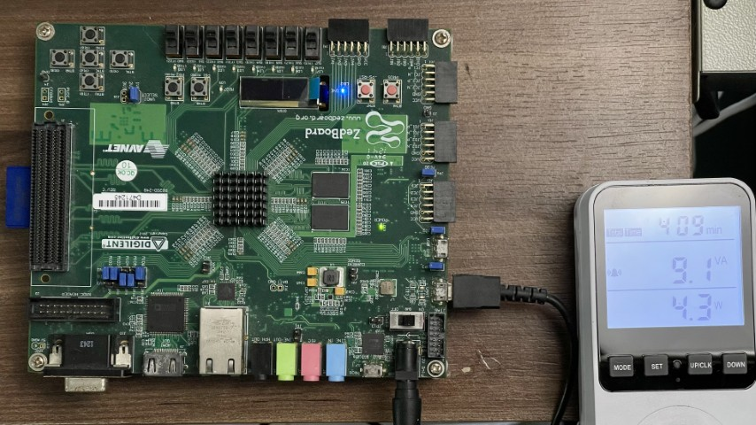
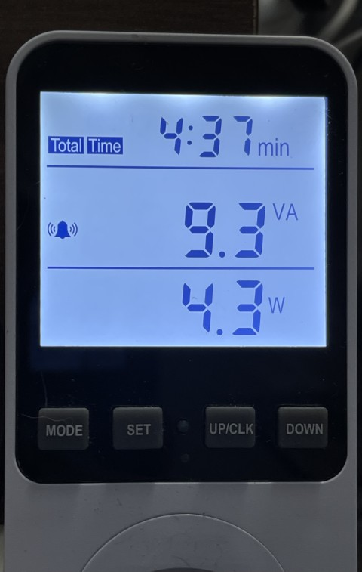
Results: Zedboard ZYNQ-7000
Execution:
Notes:
This photo shows the ZedBoard running the Double SHA-256 implementation in real hardware. The system is executing the hashing algorithm on the FPGA, controlled by the ARM processor running a bare-metal application.
On the right, you can see the power meter used to measure the energy consumption during execution. The reading indicates approximately 4.3 watts, which includes both the FPGA logic and the ARM processor.

Slide 31
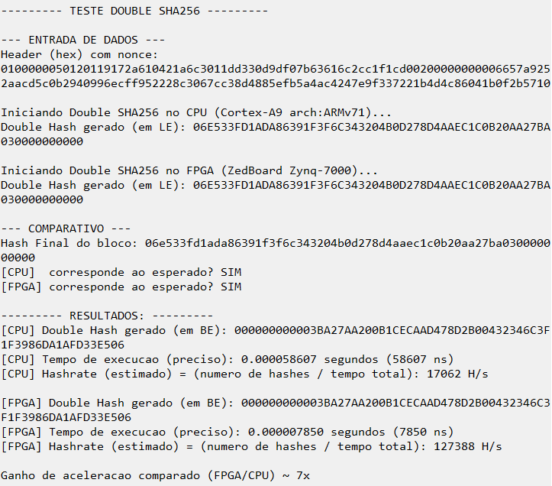
Results: Zedboard ZYNQ-7000
Terminal:
Notes:
This screenshot shows the real terminal output from the tests executed on the ZedBoard. The text is in Portuguese, because these experiments were originally conducted as part of my undergraduate capstone project.
Here we can see both the CPU and FPGA executing the Double SHA-256 algorithm using the same Bitcoin block header and nonce. The system compares the resulting hashes and verifies that both match the expected Bitcoin reference value — confirming functional correctness.
Below, the execution times are shown for each platform: the CPU required about 58 microconds, while the FPGA completed the same task in around 7 microseconds, achieving roughly a 7× speedup.
This result demonstrates the effectiveness of hardware acceleration using HLS, even on a low-cost platform such as the ZedBoard.

Slide 32
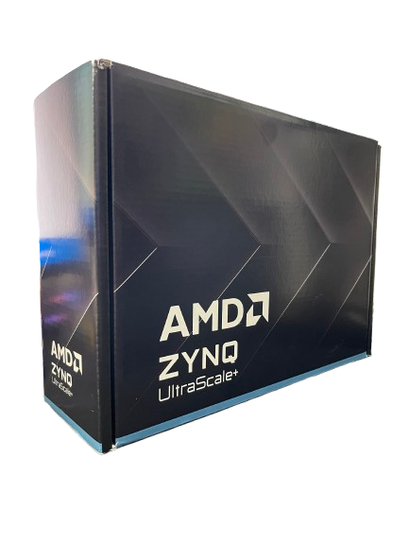
Results: Zynq UltraScale+ ZCU104
Notes:
Now, Zynq Ultrascale+ ZCU104

Slide 33
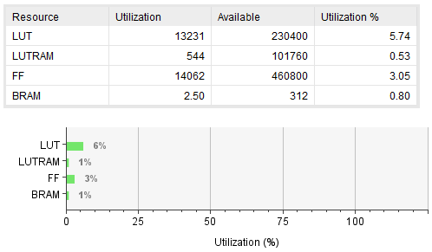
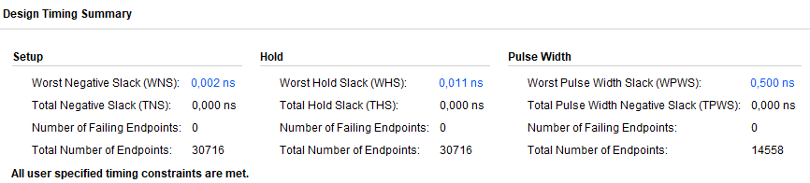
Results: Zynq UltraScale+ ZCU104
Utilization:
Notes:
This slide shows the resource utilization and timing summary for the ZCU104, which is part of the Zynq UltraScale+ MPSoC family.
The Double SHA-256 IP core here uses less than 6% of the available LUTs, and only 3% of flip-flops, with minimal use of BRAM. Compared to the ZedBoard implementation, the UltraScale+ device has a much larger logic capacity, so the relative utilization is lower, even though the same design was used.
In the timing summary below, we can see that all constraints were successfully met, with extremely small slack margins — around 0.002 nanoseconds — confirming that the design is stable and can operate at a higher clock frequency.
This demonstrates the scalability of the proposed architecture: the same IP can run efficiently on both low-end and high-end FPGA platforms, maintaining full timing closure.

Slide 34
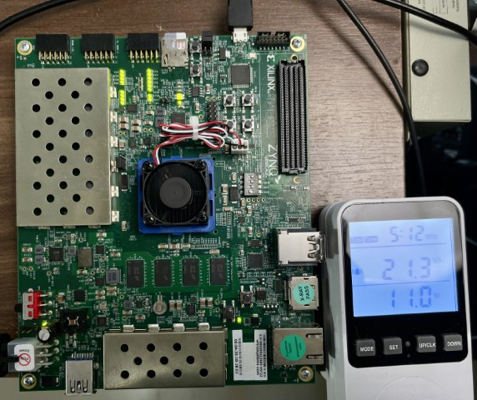
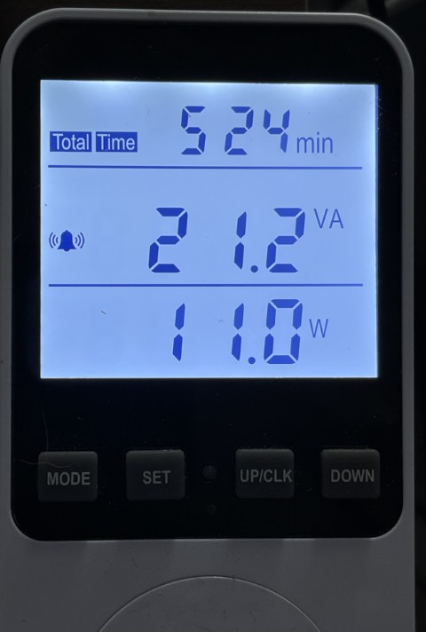
Results: Zynq UltraScale+ ZCU104
Execution:
Notes:
Here we have the ZCU104 running the same Double SHA-256 design. The FPGA operates stably at higher frequency, but with a higher power draw — around 11 watts, compared to 4 watts on the ZedBoard. Despite the increased power, it achieves a much greater performance, showing the scalability and efficiency of the architecture on a high-end FPGA.

Slide 35
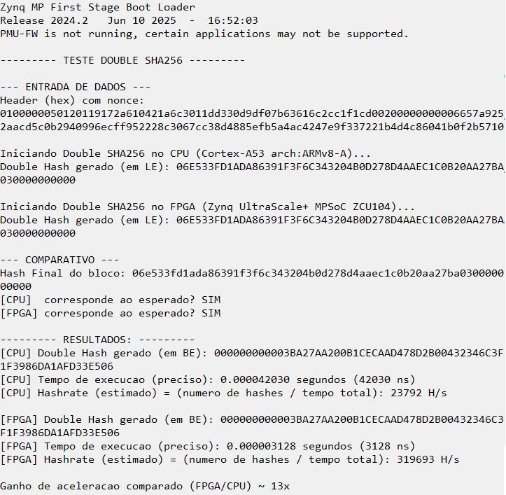
Results: Zynq UltraScale+ ZCU104
Terminal:
Notes:
Now running on the ZCU104 platform. Both the CPU and FPGA produce the same correct hash, confirming functional accuracy. The FPGA completes the computation in about 3 mcroseconds, while the ARM CPU takes 42 microeconds, resulting in roughly a 13× speedup. This highlights the performance scalability of the same Double SHA-256 IP when moved to a higher-end FPGA.

Slide 36
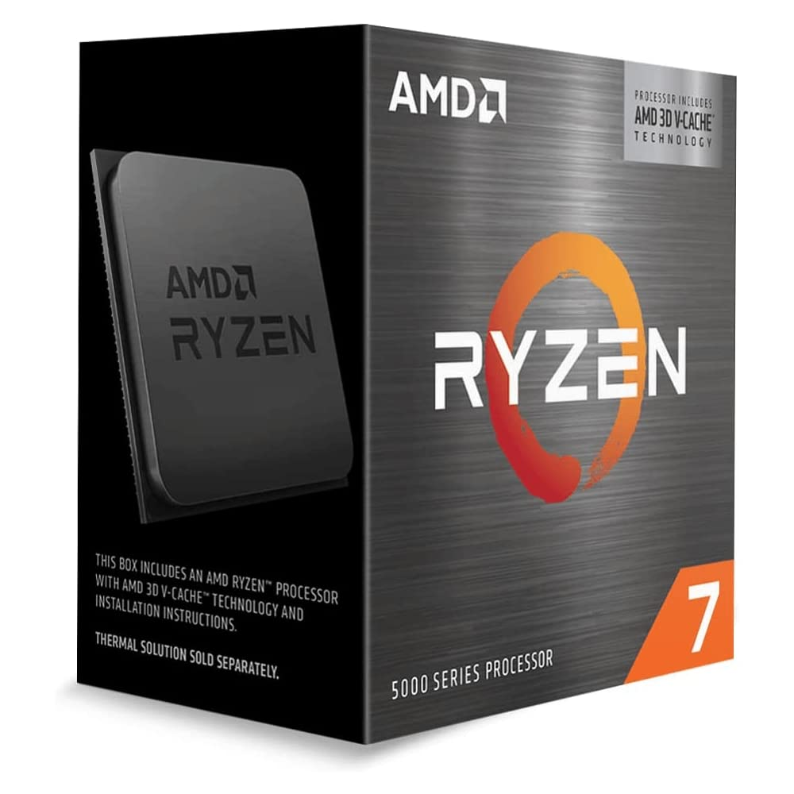
Results: CPU x86-64 Ryzen 7 5800x3D
with referency:
Notes:
To provide a realistic performance reference, we also compared the FPGA results with a desktop-class CPU. For this purpose, we selected the AMD Ryzen 7 5800X3D, a widely available consumer processor with eight cores and modern 3D-cache technology. This comparison helps illustrate how a low-cost FPGA solution performs relative to a high-end desktop system in the same Double SHA-256 computation.

Slide 37
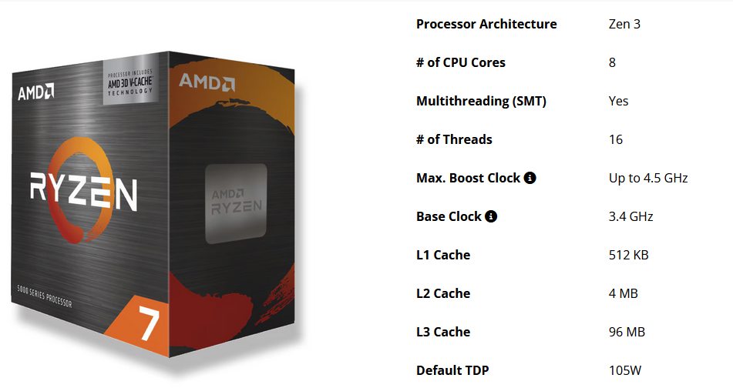
Results: CPU x86-64 Ryzen 7 5800x3D
with referency:
TDP – Thermal Design Power:
Indicates the maximum heat generated by a processor or electronic component under normal operation.
Considered value for this analysis: 105 W
Notes:
In this case, we couldn’t directly measure the CPU’s energy consumption, because a desktop system involves several other components — such as the motherboard, memory, and power supply.
Therefore, for this comparison we used the TDP, or Thermal Design Power, which represents the typical maximum power consumption of the processor under sustained load.
For the Ryzen 7, the TDP is 105 watts, and this value was adopted as a reference baseline to estimate the minimum energy usage of this CPU when running the Double SHA-256 computation.

Slide 38
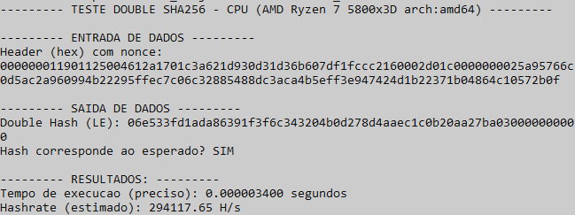
Results: CPU x86-64 Ryzen 7 5800x3D
Terminal:
Notes:
test running on the Ryzen processor. The hash result matches the expected Bitcoin reference, confirming functional correctness.
The execution time for a single hash is about 3 microseconds too, which corresponds to roughly 294 thousand hashes per second. This performance serves as the baseline reference for comparing our FPGA implementations in terms of speed and energy efficiency.

Slide 39
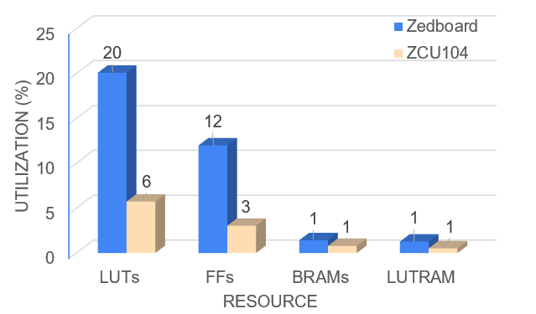
Comparative Results
FPGA Resource Utilization (%):
Notes:
Here we can see a full comparison between all tested platforms.
Let me start with resource usage. The comparison between the ZedBoard and the ZCU104 shows that the Double SHA-256 core requires a small fraction of the available FPGA fabric. Even on the smaller ZedBoard, the design uses only 20% of LUTs and 12% of flip-flops, while on the larger ZCU104 these values drop to below 6%. This demonstrates that the architecture is lightweight, scalable, and can be easily replicated for parallel validation.

Slide 40
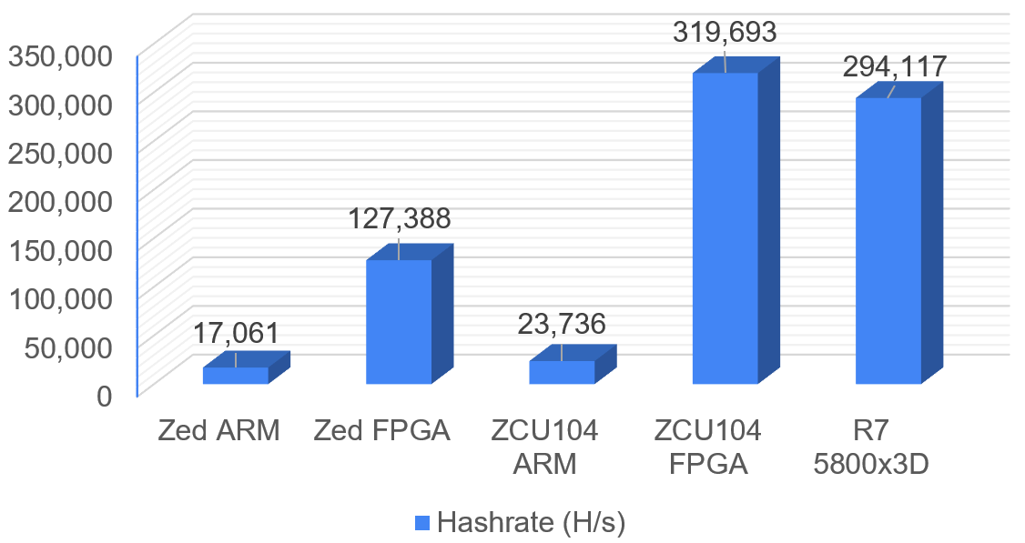
Comparative Results
Performance:
Notes:
The performance comparison shows that both FPGA platforms significantly outperform the ARM processors embedded in them. The ZCU104 reaches over 319 thousand hashes per second, slightly exceeding the Ryzen 7, while consuming a fraction of the power. When normalized by energy consumption, the FPGA achieves nearly 10× higher energy efficiency than the desktop CPU, confirming its suitability for energy-constrained blockchain applications.

Slide 41
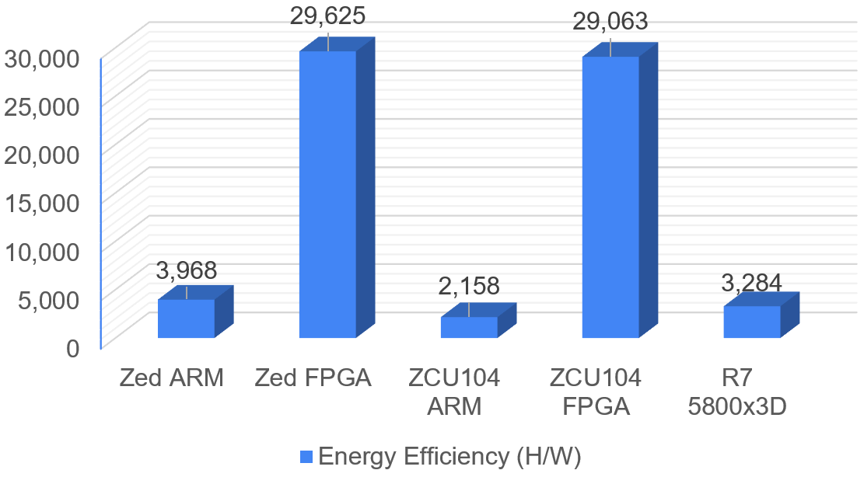
Comparative Results
Energy Efficiency (H/W):
Notes:
The energy efficiency results highlight a clear advantage of the FPGA-based implementations. Both boards — ZedBoard and ZCU104 — achieve around 30,000 hashes per watt, while the desktop Ryzen 7 remains close to 3,000 H/W. This represents an improvement of nearly 10× in performance per watt, confirming the effectiveness of hardware acceleration for blockchain validation tasks.

Slide 42
Conclusion

Slide 43
Conclusion
Summary of Contributions:
Implementation of a Double SHA-256 hardware accelerator using HLS for FPGA platforms.
Integration into a bare-metal system on ZedBoard (Zynq-7000) and ZCU104 (Zynq UltraScale+).
Validation with real Bitcoin block headers.
Achieved high performance, low power consumption, and efficient hardware utilization.
Notes:
This work presented the implementation of a hardware accelerator for the Double SHA-256 algorithm, developed in C and synthesized using High-Level Synthesis. The goal was to validate real Bitcoin block headers directly in hardware. The system was integrated into two FPGA platforms — the ZedBoard and the ZCU104 — running in a bare-metal environment, achieving high performance and low power consumption with efficient use of logic resources.

Slide 44
Conclusion
Key Results:
ZCU104: 319 kH/s — 3.1 µs per hash.
ZedBoard: 29.6 kH/W — highest energy efficiency.
FPGA outperformed ARM processors and matched desktop CPU throughput.
Demonstrated ~10× energy efficiency advantage over CPU.
Notes:
The experimental results show that the ZCU104 reached over 319 thousand hashes per second, with an average execution time of only 3 microseconds per hash. The ZedBoard achieved the best energy efficiency, around 30 thousand hashes per watt. Both FPGA implementations outperformed the embedded ARM processors and reached a performance level comparable to a desktop CPU, while being ten times more energy efficient.

Slide 45
Conclusion
Future Work and Perspectives:
Parallelization of multiple SHA-256 cores.
Dynamic clock scaling for better power efficiency.
Partial reconfiguration and integration with lightweight OS.
Potential for embedded blockchain validation and IoT cryptography.
Notes:
For future work, we plan to parallelize multiple SHA-256 cores to further increase throughput, and apply dynamic clock scaling to reduce power consumption even more. The architecture can also be extended to support other blockchain algorithms, such as SHA-3 or Blake2b, and integrated with lightweight operating systems, enabling its use in blockchain validation nodes or IoT devices with embedded cryptographic processing.

Slide 46



Acknowledgments
Notes:
Before finishing, I’d like to acknowledge the support from UNIEDU, CNPq, and FAPESC, which provided financial and institutional support for this research. I also thank the LEDS Research Group and my co-authors for their collaboration and guidance throughout this work.

Slide 47
Implementation of Double SHA-256 in HLS for FPGA Using Real Bitcoin Blocks
Bernardo V. S. Pinto, Douglas R. Melo, Cesar A. Zeferino, Eduardo A. Bezerra, Felipe Viel
LEDS, Universidade do Vale do Itajaí, Brasil
berna@edu.univali.br
Notes:
That concludes my presentation. Thank you all for your attention. If you have any questions, I’ll be happy to answer them. You can also reach me by email at berna@edu.univali.br

